Slide 1
Customer Segmentation
by
K Means Clustering Algorithm
Using R programming

Slide 2
GUIDED BY
Prof: Dr. Scahi Nandan Mohanty
SUBMITTED BY
NAME: Rampam Greeshma Geethika
REG.NO: 20BCD7094
LAB SLOT: L23+L24
GROUP 36

Slide 3
INTRODUCTION:
Customer segmentation is one of the most popular data science projects. Customer segmentation is a well-known example of unsupervised learning. Companies use clustering to identify customer groups and target potential user bases. Segment consumers based on common characteristics such as gender, age, hobbies, and purchasing patterns to effectively sell to each group. You can visualize the distribution of gender and age using K-means clustering. Then look at their annual income and spending patterns.

Slide 4
Methodology:
The dataset is saved as a Mall_Customers.csv file. This dataset contains 400 records of various types of customers. The events saved in the dataset are unstructured. To perform analysis, reading data is done using the command “read.csv”.
Analysed using code:
Customer Gender Visualization
Visualization of age distribution
Analysis of the annual income of customers
K MEANS Clustering
Visualizing the clustering results using the first two principle components

Slide 5
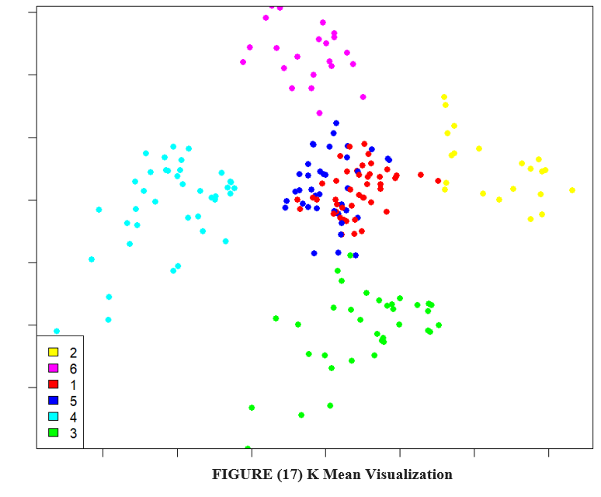
RESULTS:

Slide 6
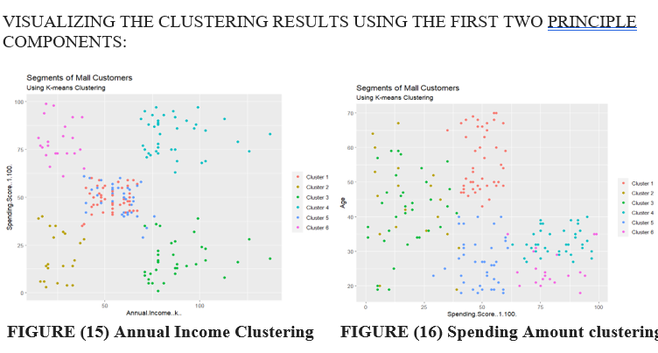

Slide 7
With the help of clustering, variables can be better understood by careful decision. Identifying customers allows companies to release products and income, age, spending patterns, etc. In addition, more complex patterns such as product ratings are considered for better segmentation.

Slide 8
CONCLUSION:
Overall, the goals and applications defined in this study were achieved by machine learning models. This work also demonstrates the importance of consulting a data scientist before starting monitoring, as datasets that are not suitable for the task requested are a common problem.
A K-Nearest Neighbour (KNN) model has been used for data imputation and has been used successfully. It has been proposed to other researchers for this task. However, it is worth noting that many of the neighborhood data used for this study are not universal and may be found in different sets that are suitable for different datasets.
The classification model works well and can make very accurate predictions
A model for determining the season of the sample and the land use of the area where the sample was collected.

Slide 9
THANK YOU

